Slide 1
METEOHACK 2019
- - - -
Team GEOHACK How to create a flood index

Slide 2
Flood Index

Slide 3
FLOOD INDEX - Background
Three categories of flood – Low, Medium, High
How to define or quantify these classes?
Create an index
Define index within the guidelines provided
20 years of hydrometric data – requires historical daily peakflow data
Three categories of flood
Q₀ – current water flow at station (watershed) per unit time
Where time = Every 5 minutes

Slide 4
FLOOD INDEX – PROOF OF CONCEPT (POC)
Use 100 years of hydrometric data – use historical annual peakflow
Three categories of flood – low, medium, high
Define Q₀ as daily mean flow at station (watershed)
Project requires 5 minutes, but POC can be daily (other time units – hourly)

Slide 5
FLOOD INDEX - METHODOLOGY
Categorical flood index is calculated using 3 main variables.
Daily mean peakflow, annual mean peakflow (assumption: from average of daily peakflow) and annual peakflow (maximum peakflow in a given year)
*Based on 100 year historical data (time series)
Calculate peakflow per station (scalar value)
Perform a frequency analysis - using FAST Fourier Transform
Magnitude of resulting FFT gives scalar value

Slide 6
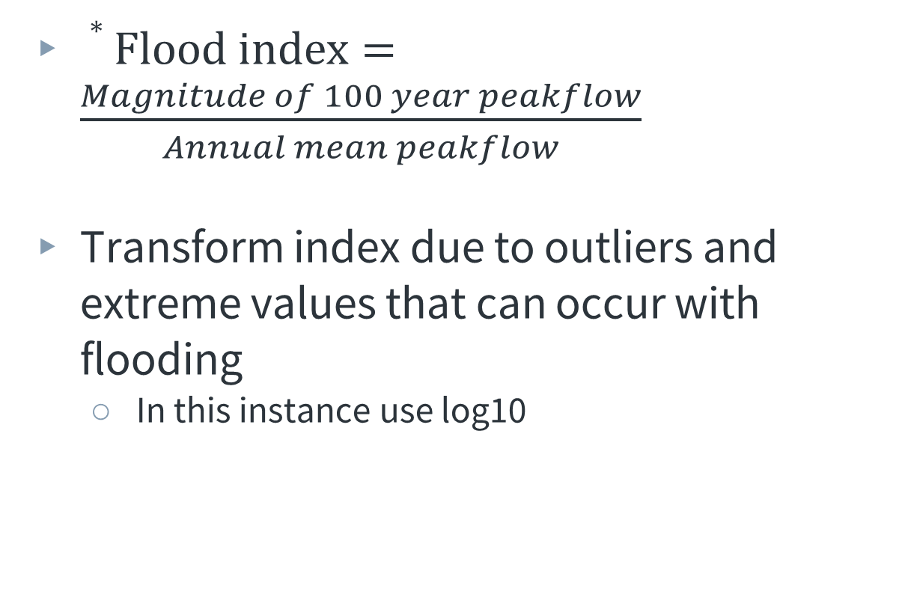
FLOOD INDEX - METHODOLOGY
$∗Flood index=\frac{Magnitude of 100 year peakflow}{Annual mean peakflow}$
Transform index due to outliers and extreme values that can occur with flooding
In this instance use log10
* Vulnerability Measures for Flood and Drought and the Application in Hydrometric Network Design, Mohammad Reza Moazezi Zadeh Tehrani, PhD thesis, University of Waterloo

Slide 7
FLOOD INDEX - RESULTS
Flood index varies from -2.92 to 3.72
Create numerical index for alerts using quantiles
If necessary scale index to lie between 0 and 1
Ease of communicating danger/on-danger
More user friendly in an app
Alert | Quantile (%) | Index | Approximation
Low | 25 | < 0.55 | < 0
Medium | 25-75 | 0.55 to 1.06 | 0 to 1.0
High | 75 | > 1.06 | > 1.0

Slide 8


FLOOD INDEX – FUTURE WORK
Future work or iterations
Change daily flow to hourly or 5 minute flow
Consider the effects of equations used in flash flooding in building actual or real-time model
In lieu of historical data (1 hour or 5 minute) not being available create a separate model for predicting 48 hour (unit time) forecasts (P_{forecastesd})

